Slide 2
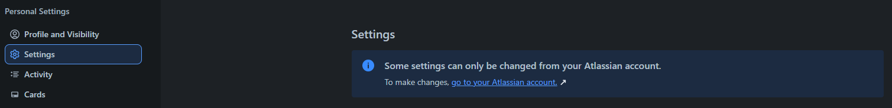



MAIN FUNCTIONALITY IN THE TRELLO SYSTEM
bbv Software Services AG | 21/07/2025

Slide 3
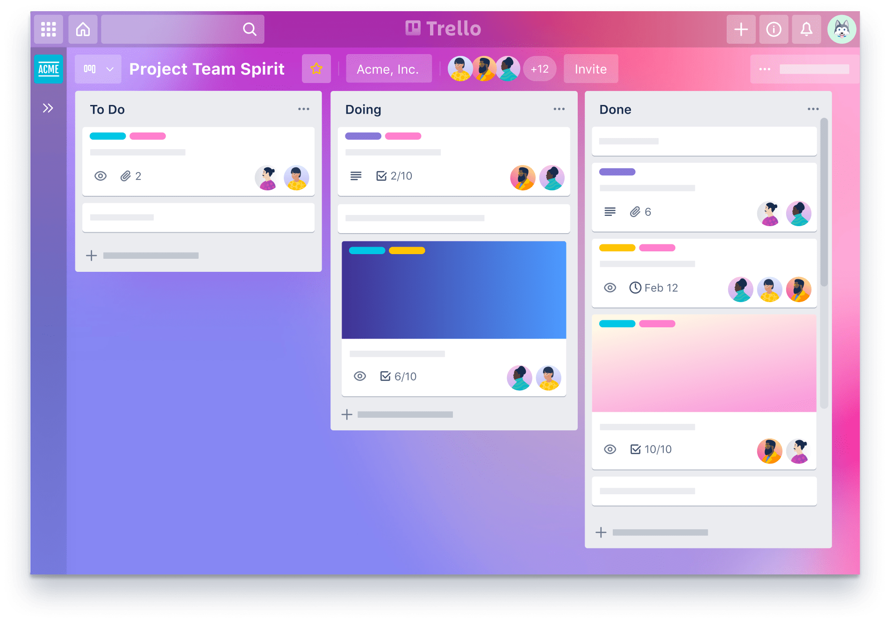
Agenda
Introduction to Functionality
UI in the Trello System
Entities in Trello System
Q&A

Slide 4
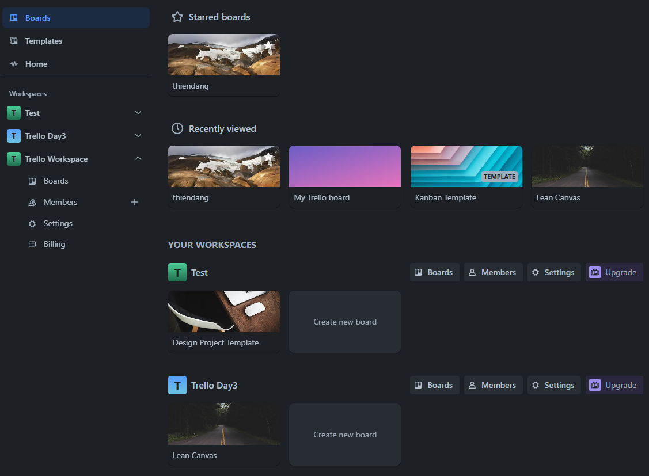
BOARDS TAB IN TRELLO SYSTEM
Board
Workspace

Slide 5
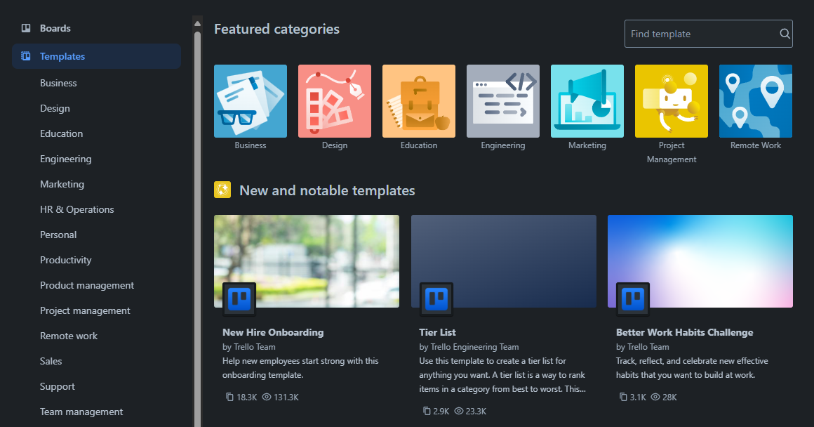
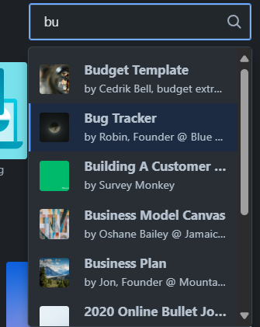
TEMPLATE TAB IN TRELLO SYSTEM
TemplateCategory
Template

Slide 6

TEMPLATE TAB IN TRELLO SYSTEM
TemplateCategory

Slide 7
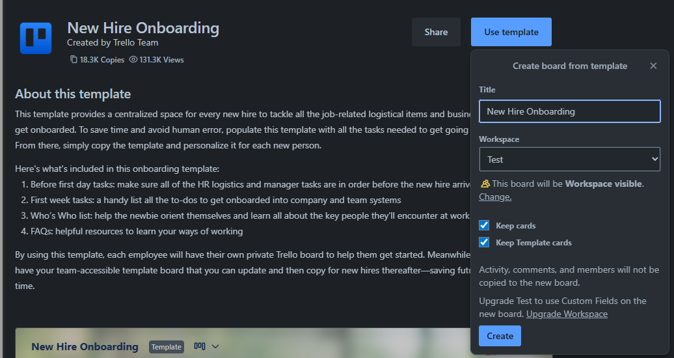
TEMPLATE IN TRELLO SYSTEM
Template
Board

Slide 8
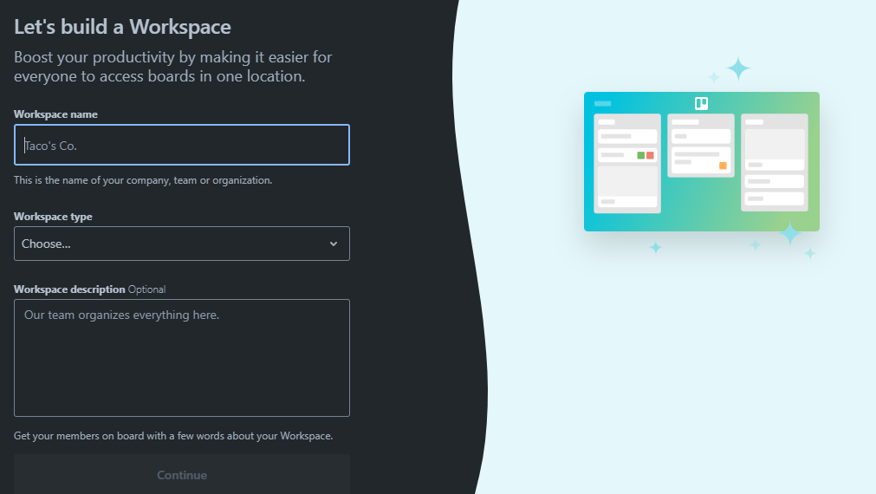
CREATE WORKSPACE IN TRELLO SYSTEM
Workspace Information

Slide 9
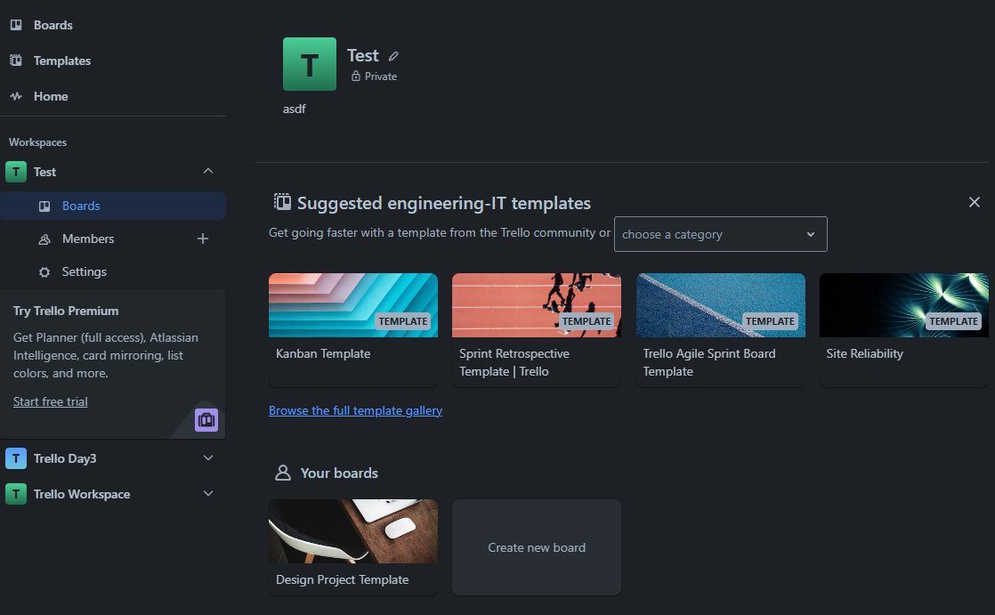
WORKSPACE IN TRELLO SYSTEM
Click here
Template
Board

Slide 10
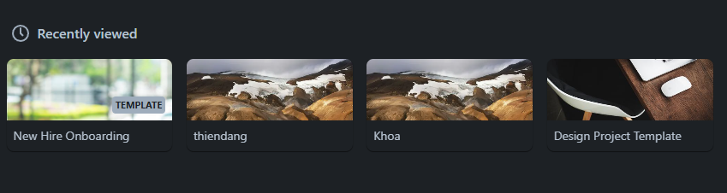
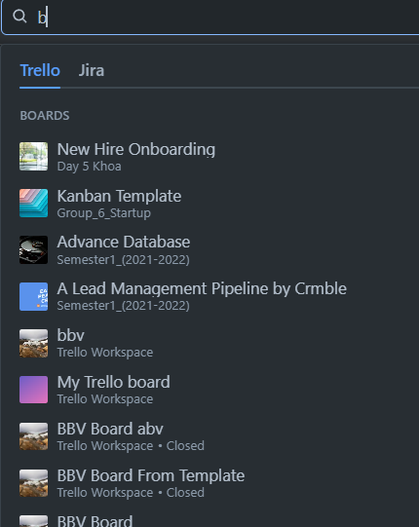
USERBOARDRECENTLYVIEW
IN TRELLO SYSTEM
UserBoardRecentlyView

Slide 11
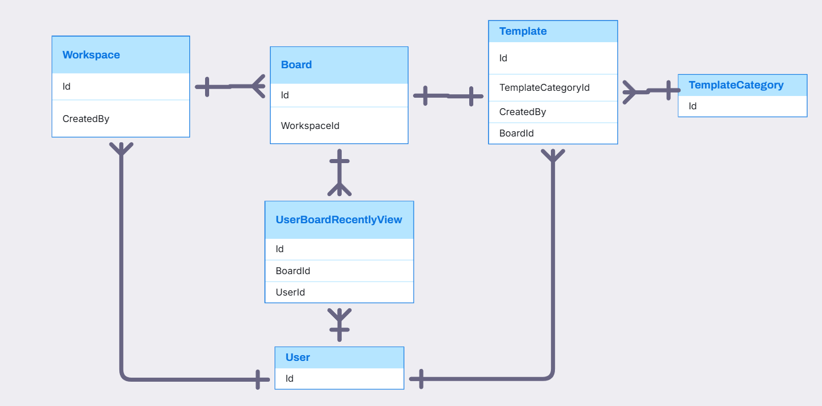
USER, WORKSPACE, BOARD, TEMPLATE, TEMPLATECATEGORY, USERBOARD RELATIONSHIP

Slide 12
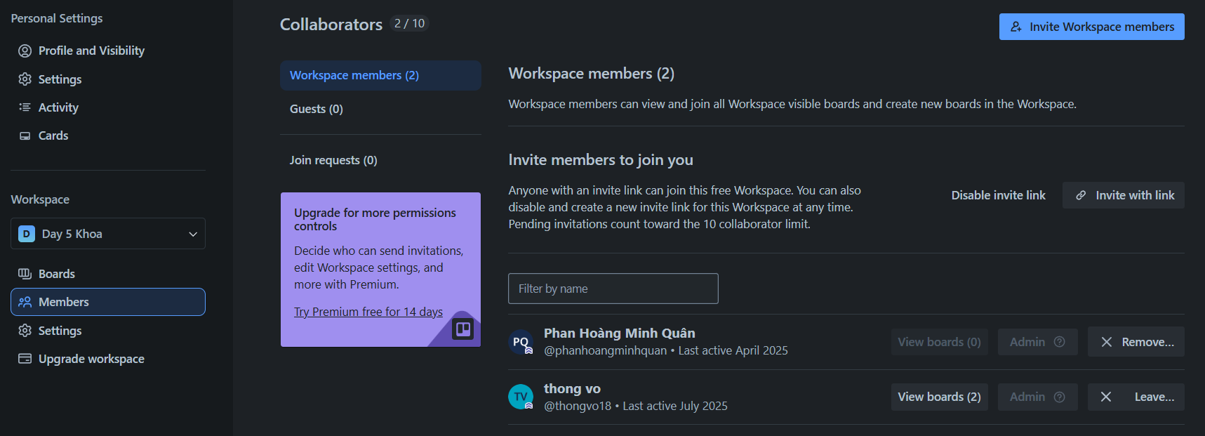
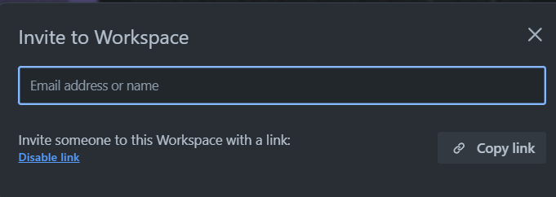
WORKSPACE IN TRELLO SYSTEM
ShareLink
Member
Permission

Slide 13
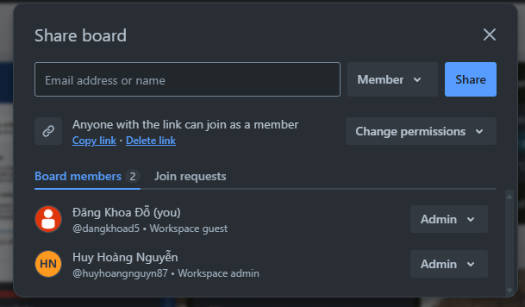
WORKSPACE IN TRELLO SYSTEM
ShareLink
Member
Permission

Slide 14
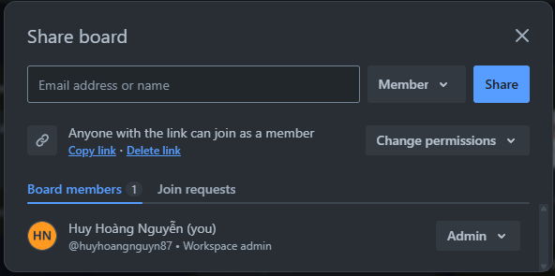
BOARD SHARE IN TRELLO SYSTEM
Add member to board with permission
Member Permission
Share link with permission

Slide 15
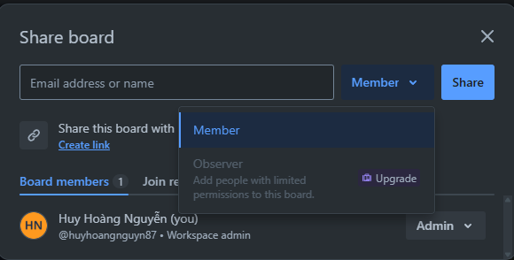
BOARD SHARE IN TRELLO SYSTEM
Permission code with admin, member, observer

Slide 16
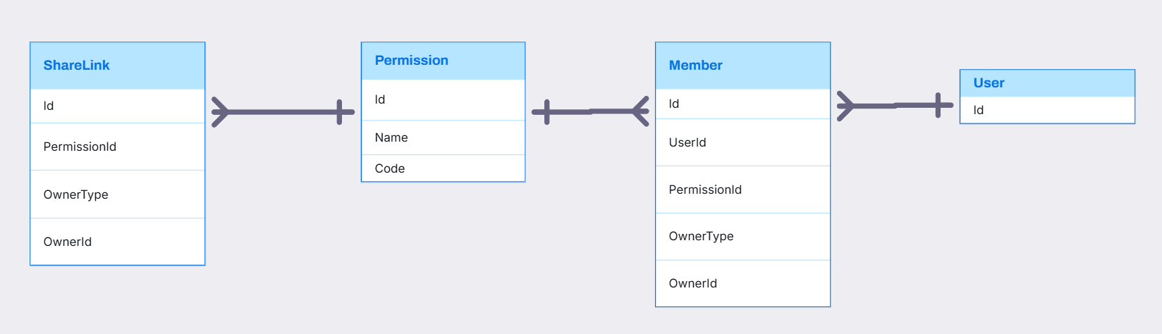
SHARELINK, PERMISSION, MEMBER RELATIONSHIP

Slide 17
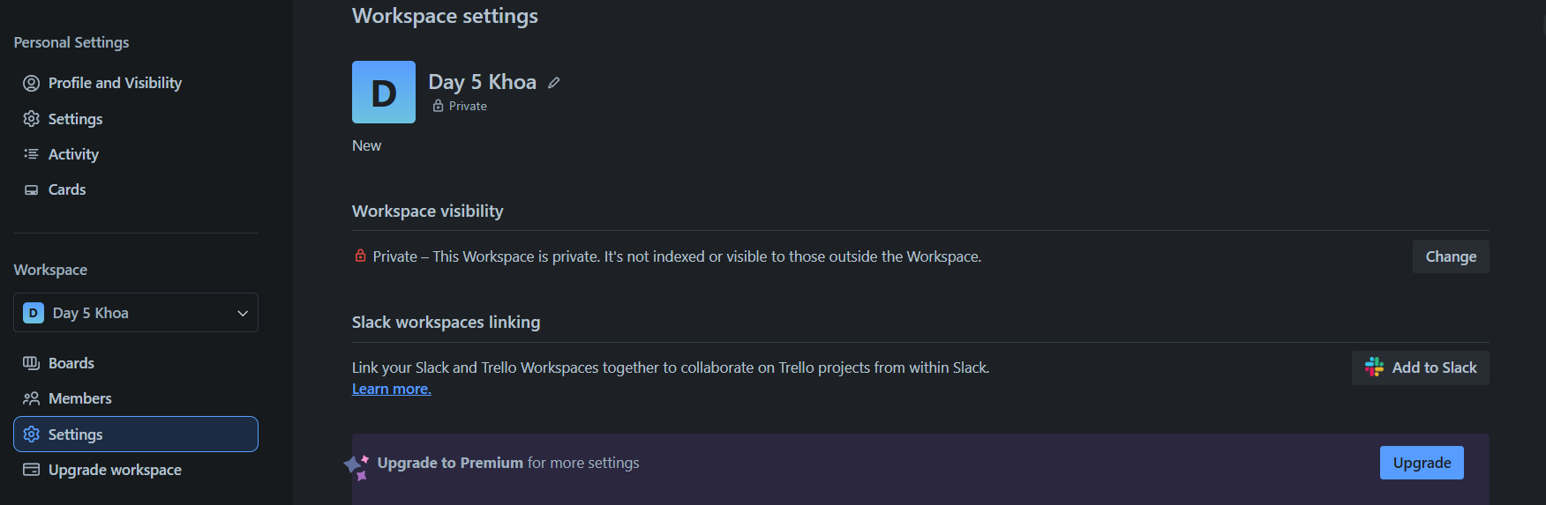
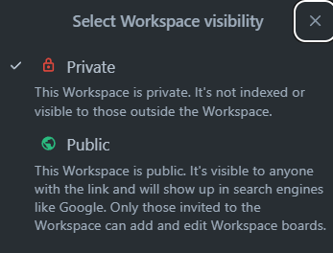
WORKSPACE SETTING IN TRELLO SYSTEM
SettingKey
SettingOption
SettingValue

Slide 18
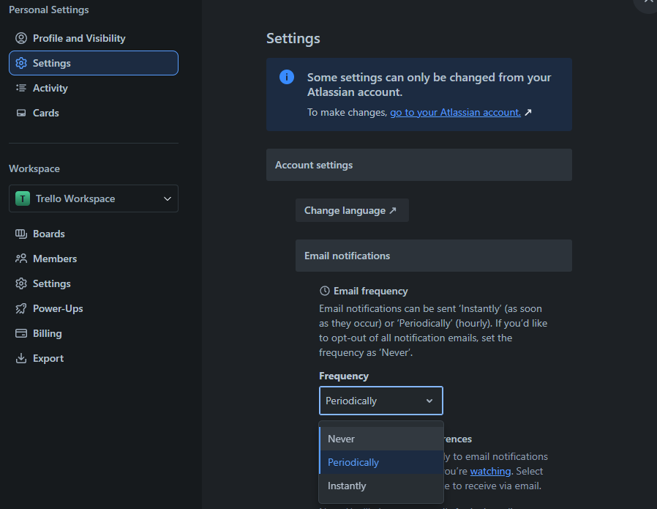
USER SETTING IN TRELLO SYSTEM
SettingKey
SettingValue
SettingOption

Slide 19
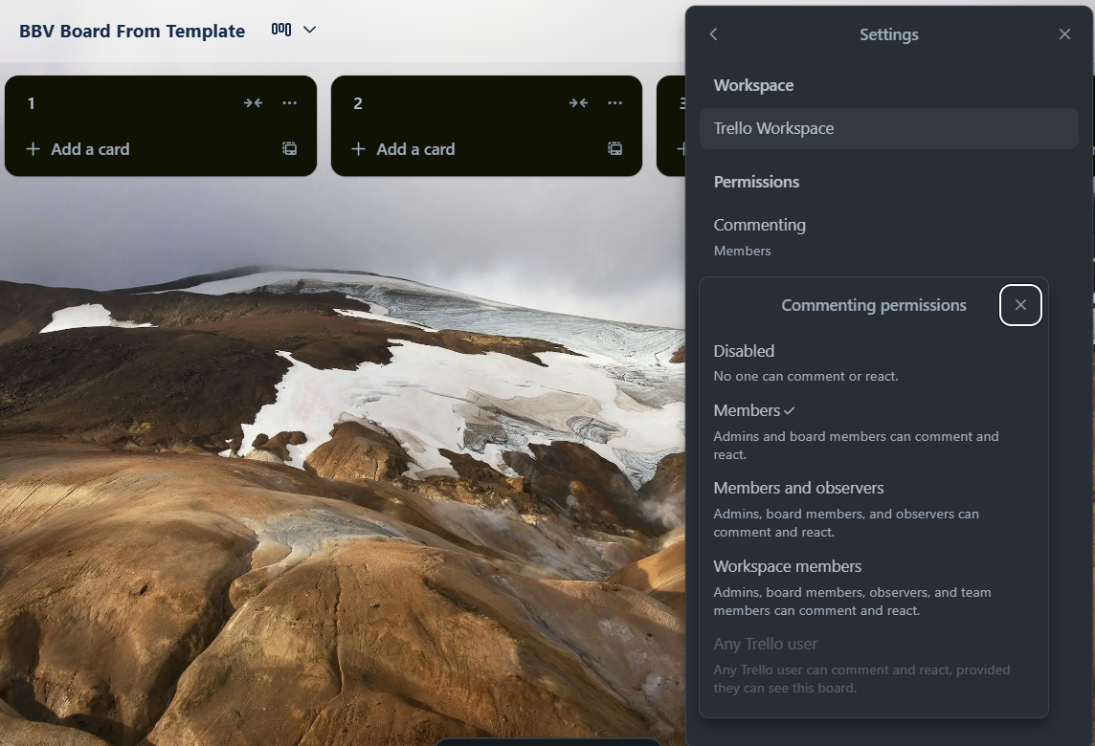
BOARD SETTING IN TRELLO SYSTEM
SettingKey
SettingValue
SettingOption

Slide 20
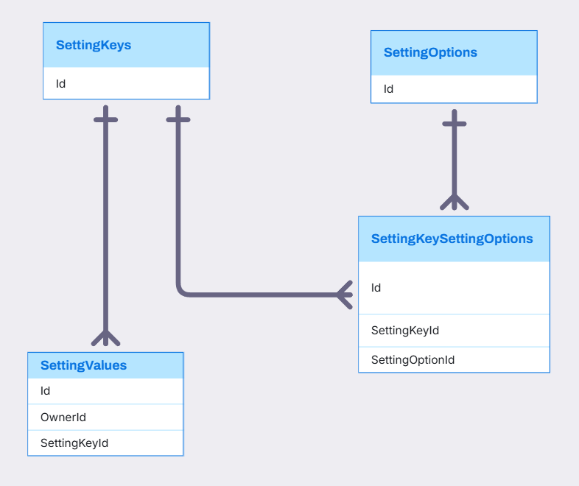
SETTINGKEY, SETTINGOPTION, SETTINGVALUE, SETTINGKEYSETTINGOPTION RELATIONSHIP

Slide 21
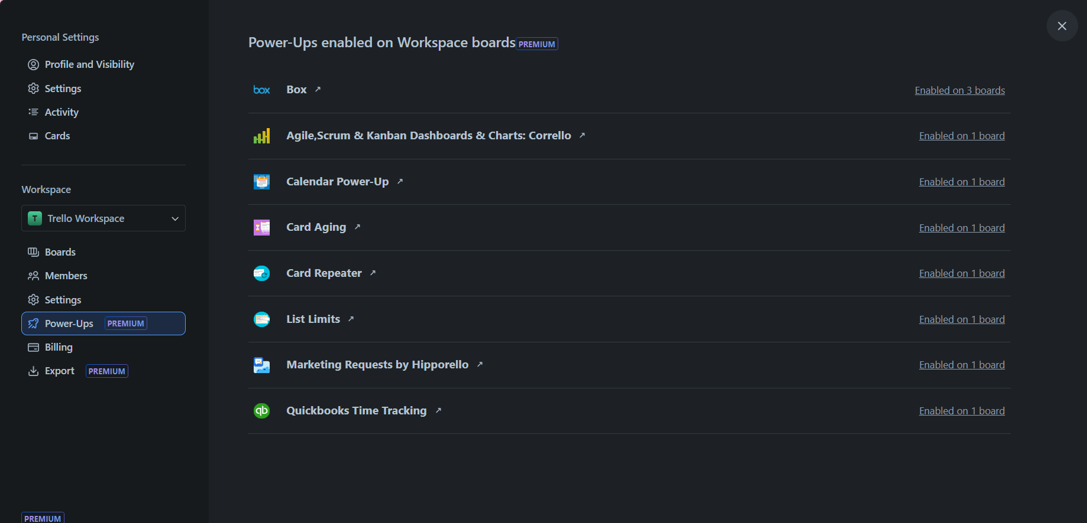
WORKSPACE IN TRELLO SYSTEM
Power-up

Slide 22
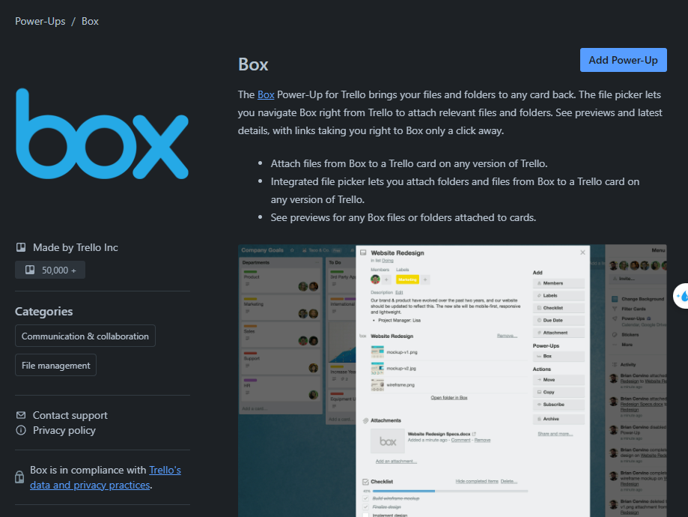
WORKSPACE IN TRELLO SYSTEM
Title
Description
AuthorName
PowerUpsCategory

Slide 23
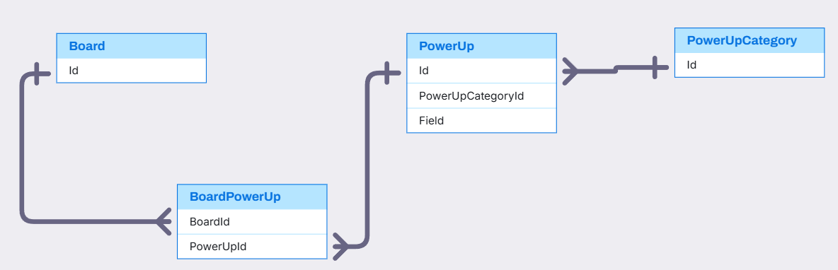
BOARD, POWERUP,POWERUPCATEGORY RELATIONSHIP
PowerUp,PowerUpCategory,Board(Quan)

Slide 24
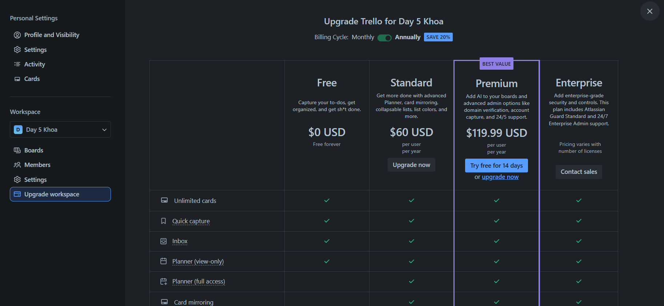
WORKSPACE IN TRELLO SYSTEM
BillingPlan

Slide 25
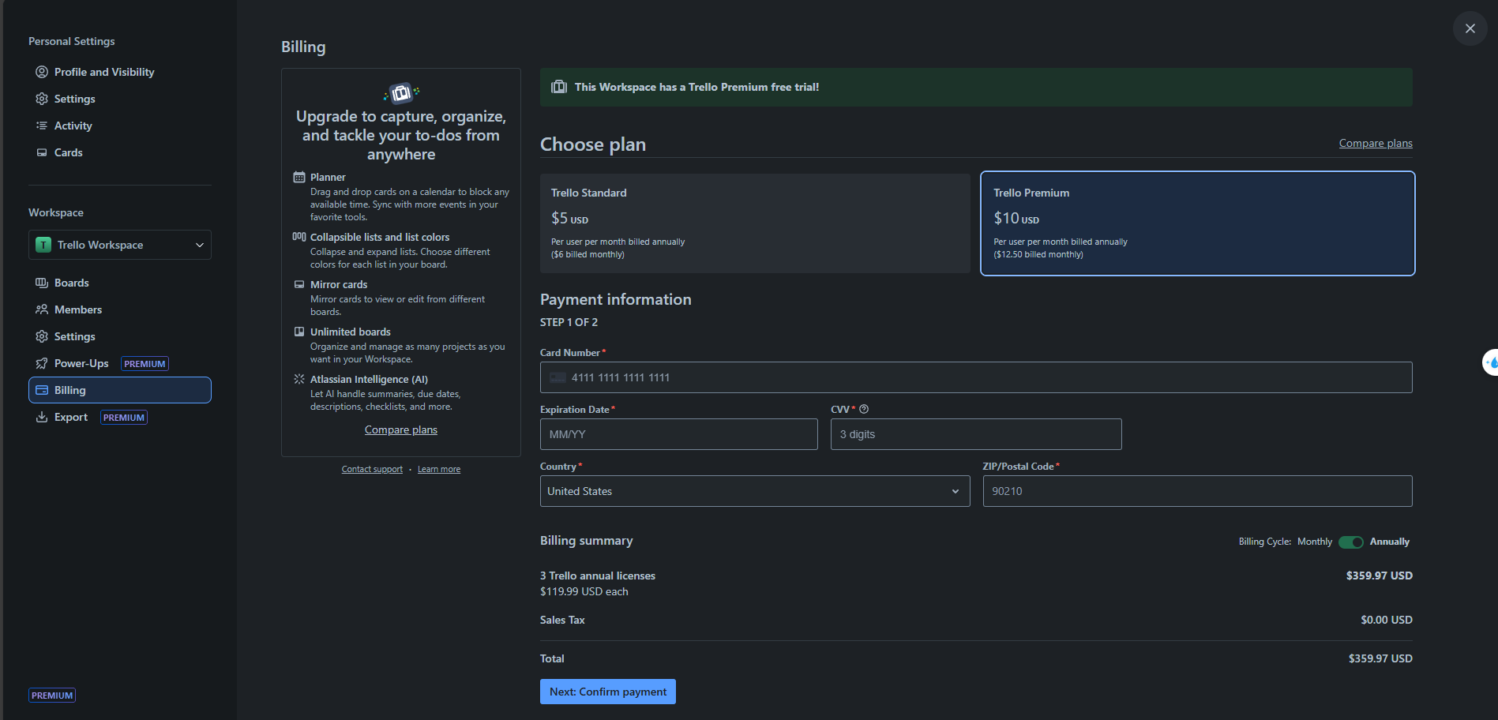
WORKSPACE IN TRELLO SYSTEM
BillingPlan
PaymentInformation

Slide 26
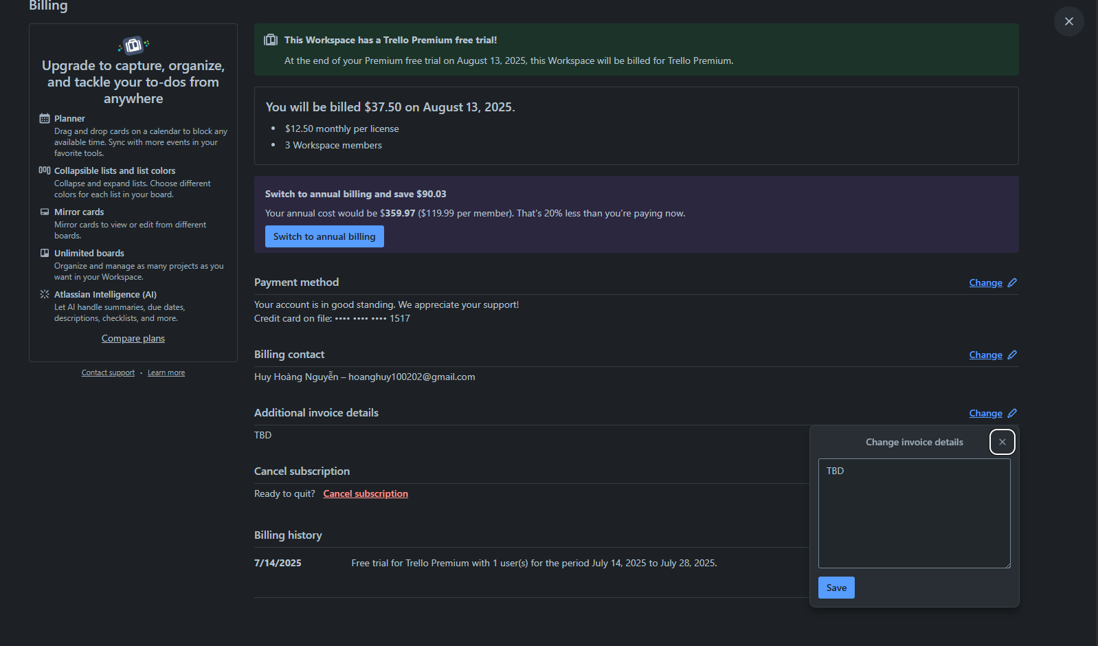
BILLING IN TRELLO SYSTEM
Billing.AdditionalInvoiceDetail

Slide 27
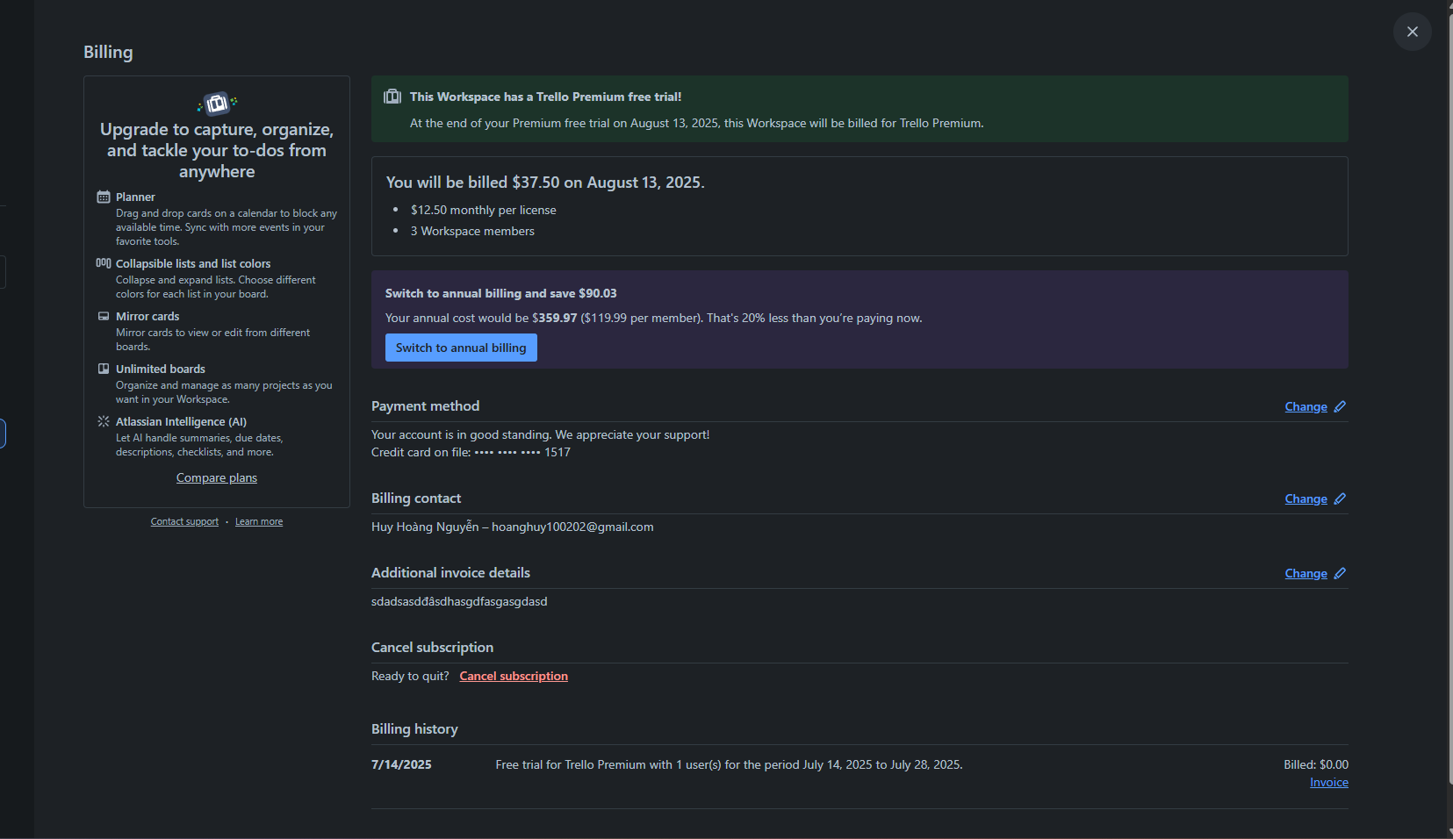
BILLING IN TRELLO SYSTEM
Subscription
Billing.AdditionalInvoiceDetail
Query from subscription

Slide 28
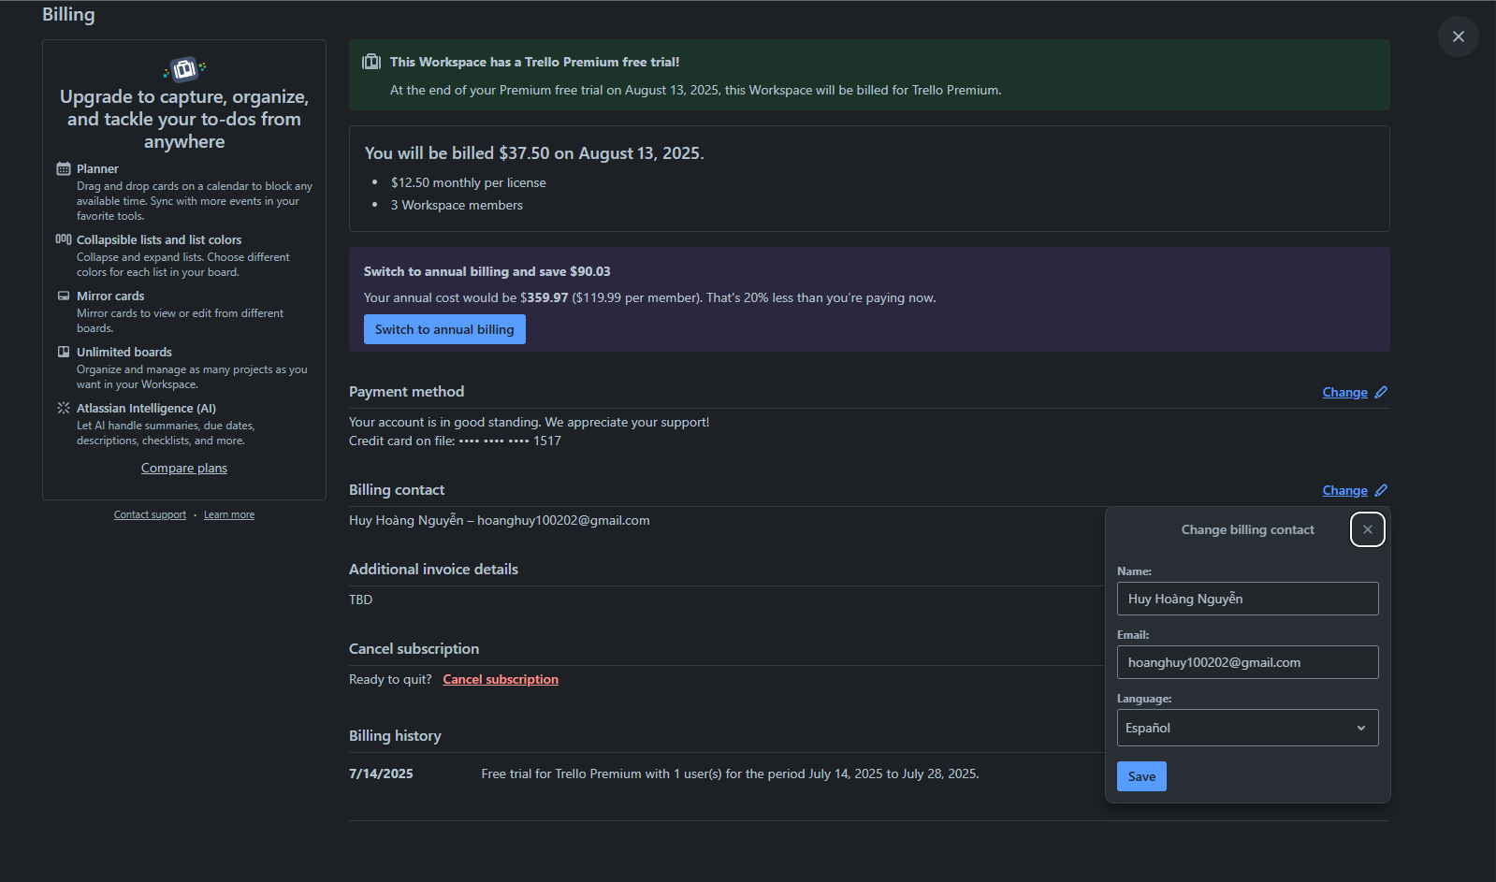
BILLING IN TRELLO SYSTEM
BillingContact

Slide 29
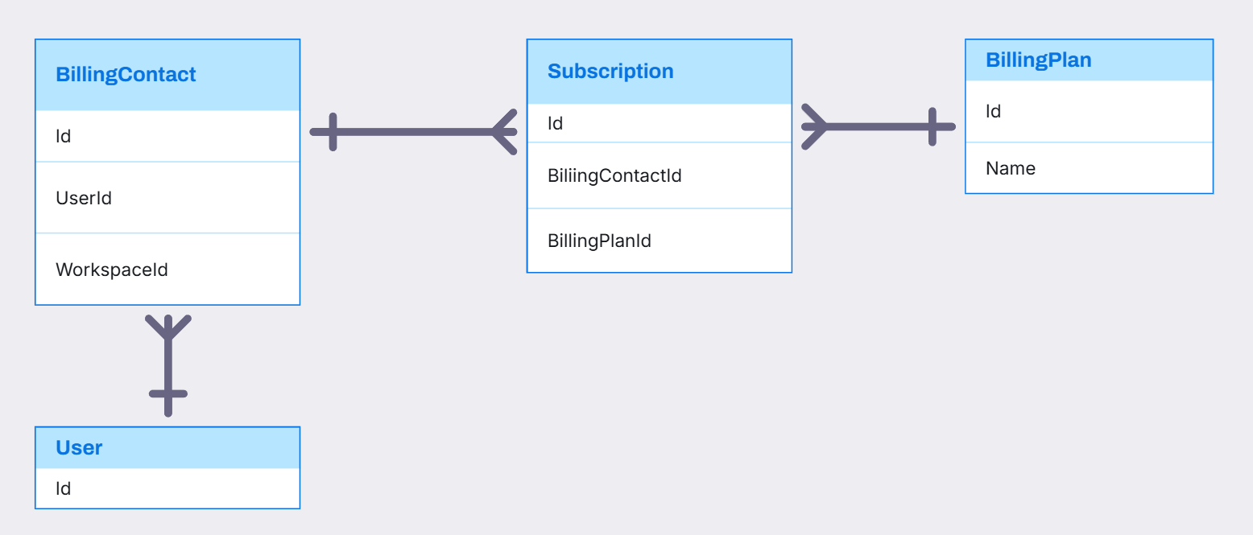
BILLINGCONTACT, BILLINGPLAN, SUBSCRIPTION RELATIONSHIP

Slide 30
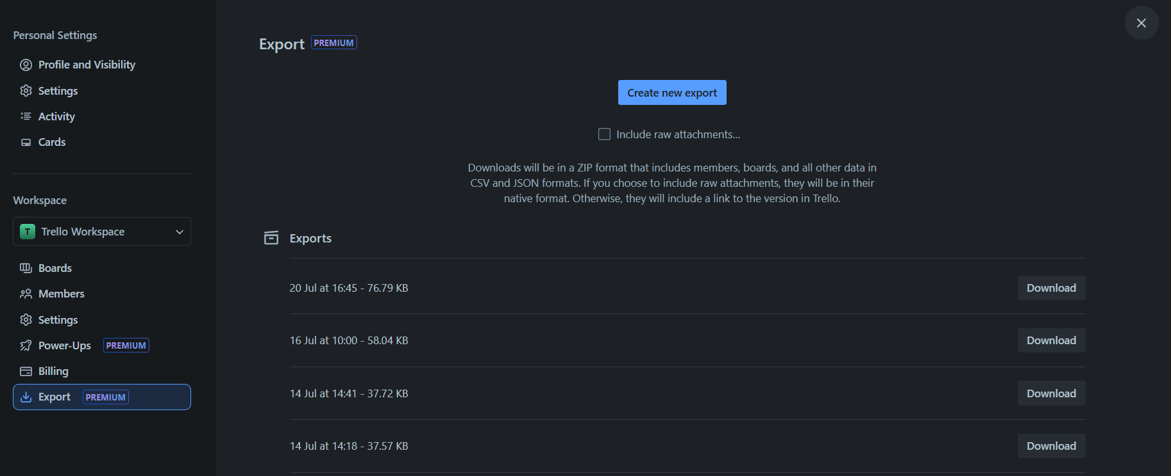
WORKSPACE IN TRELLO SYSTEM
Export

Slide 31
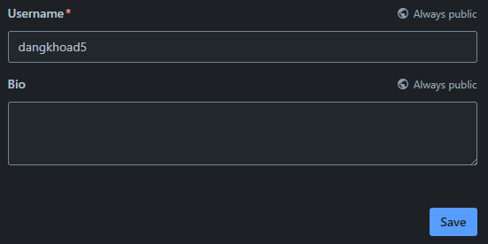
USER IN TRELLO SYSTEM
Username
UserBio

Slide 32
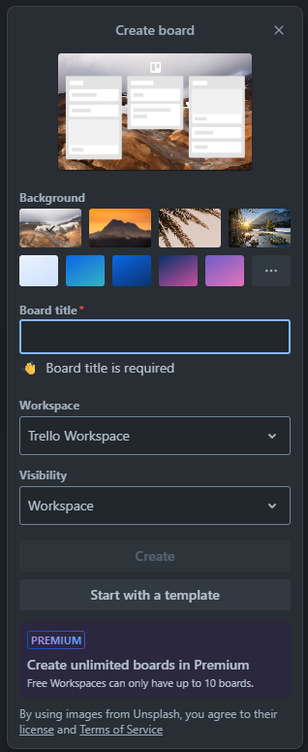
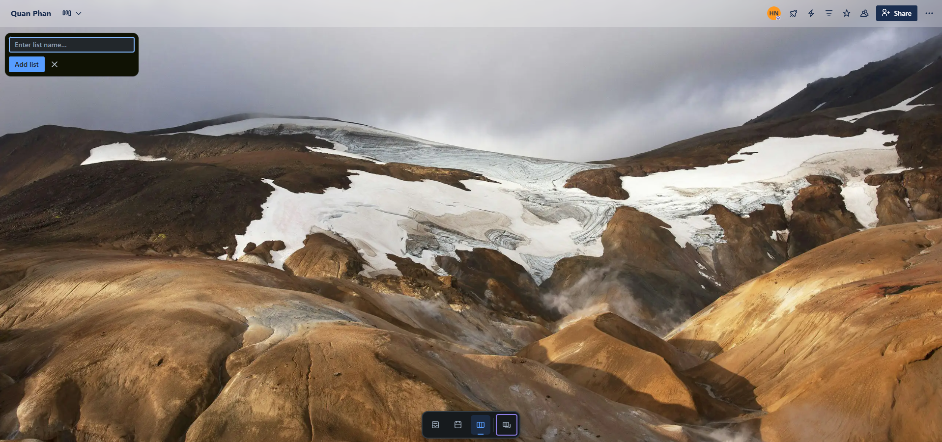
BOARD IN TRELLO SYSTEM
Stage
Board

Slide 33
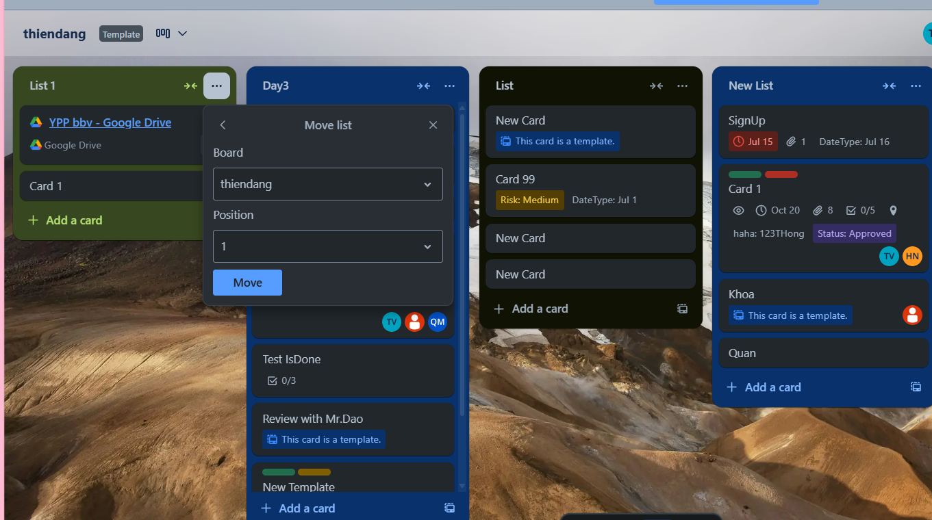
STAGE IN TRELLO SYSTEM
Stage Position

Slide 34
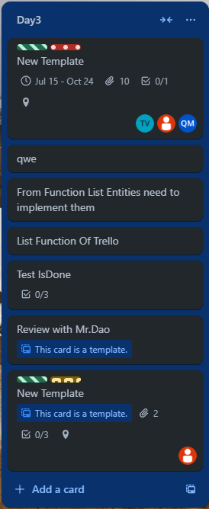
STAGE IN TRELLO SYSTEM
Stage
Card

Slide 35
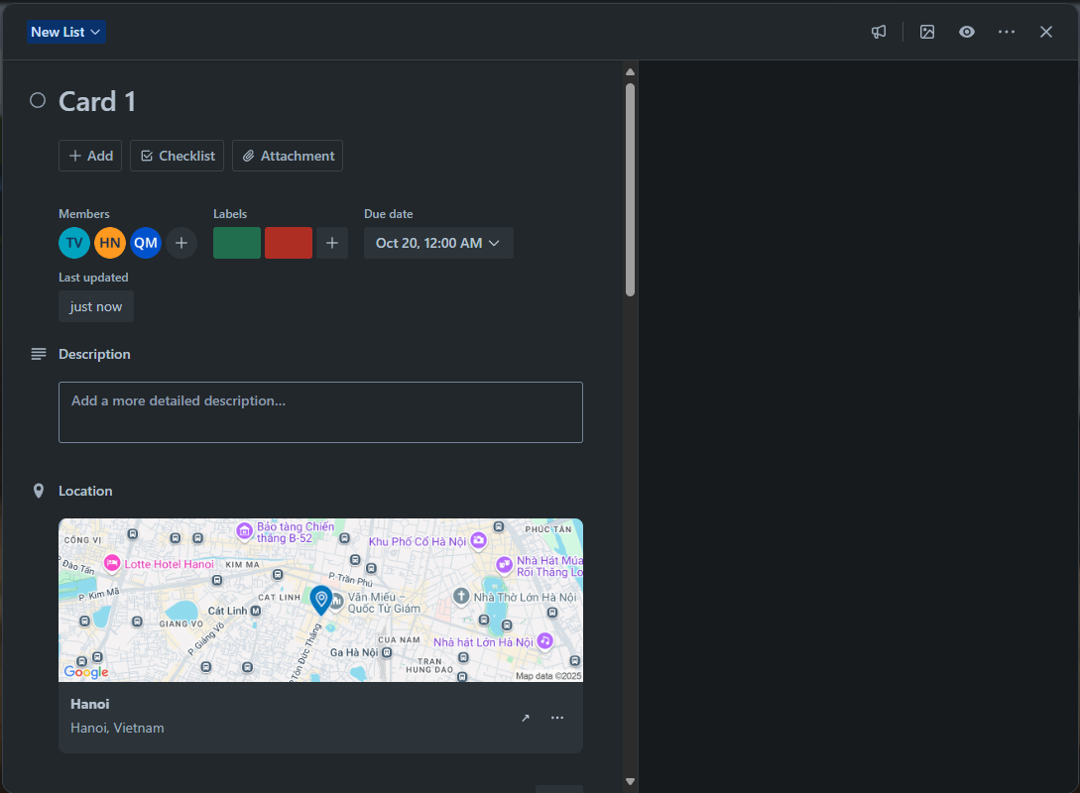
CARDS IN TRELLO SYSTEM
Member Card
CardDate
Label
CardDescription
CardLocation

Slide 36
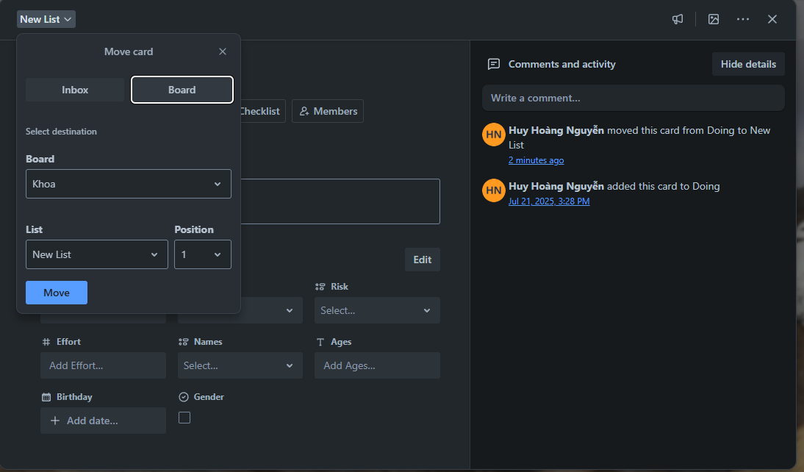
CARDS IN TRELLO SYSTEM
Card Activities
Card Position

Slide 37
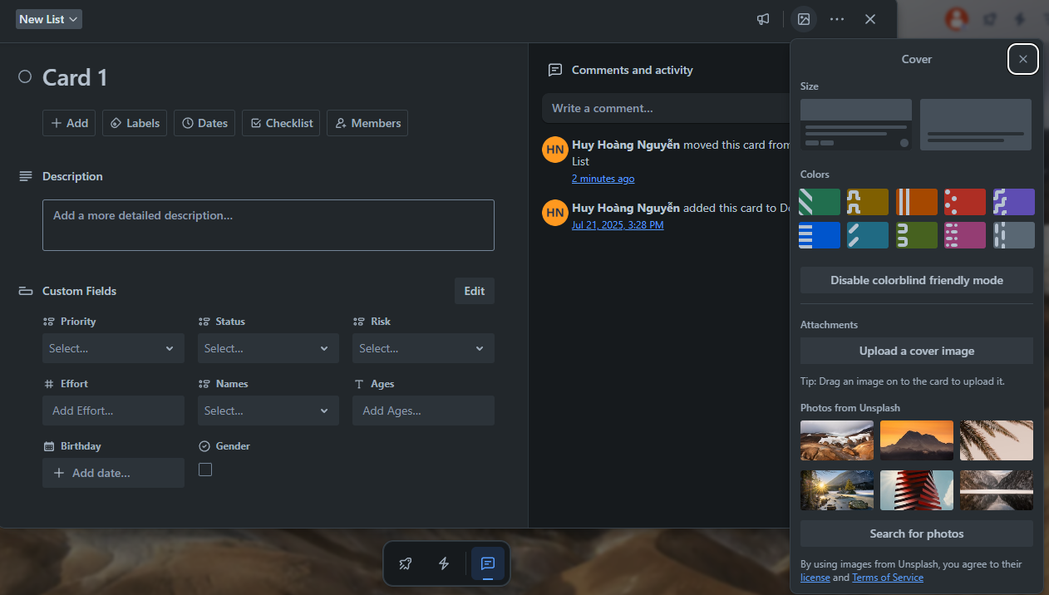
CARDS IN TRELLO SYSTEM
Color
Attachment
Card Cover
UnsplashImg

Slide 38
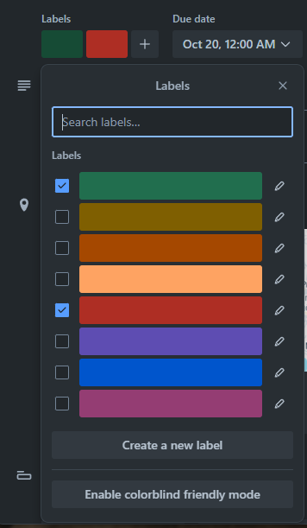
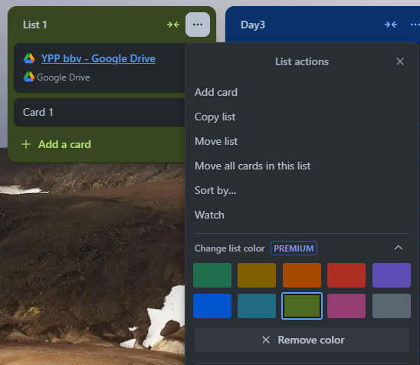
LABEL AND COLOR IN TRELLO SYSTEM
Label
Color

Slide 39
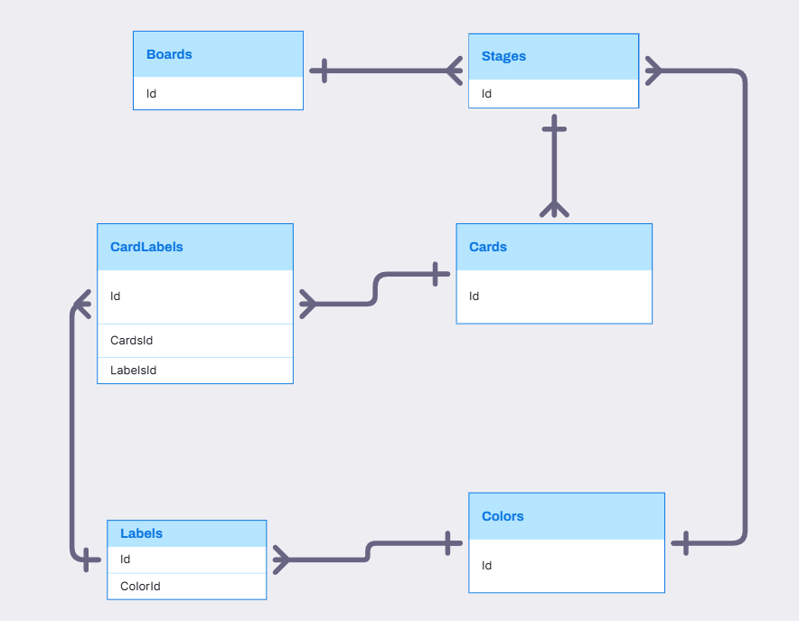
BOARD, STAGE, CARD, LABEL, COLOR RELATIONSHIP

Slide 40
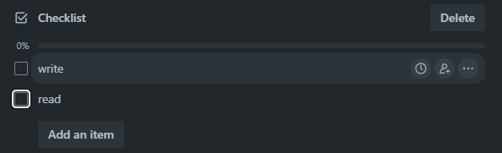
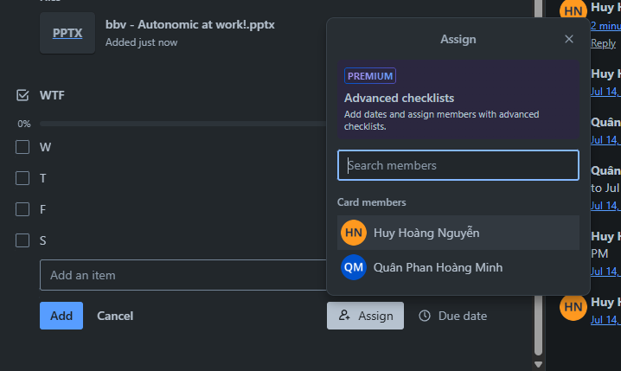
CHECKLIST IN TRELLO SYSTEM
CheckListItem
CheckList
Assign Member Into CheckListItem

Slide 41
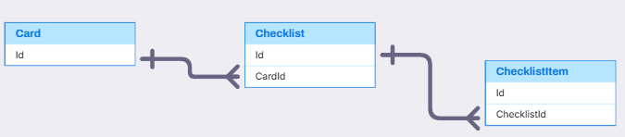
CARD, CHECKLIST, CHECKLISTITEM
Card, CheckList, CheckListItem(Quân)
,
,

Slide 42
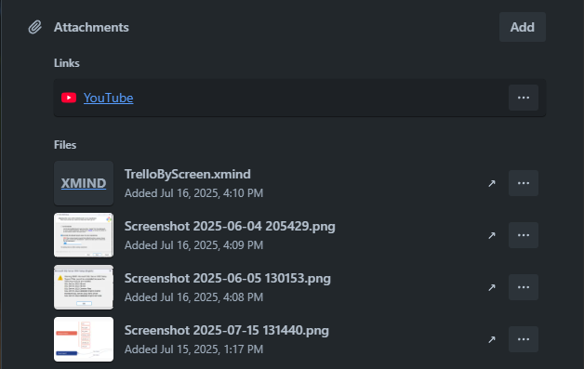
ATTACHMENT IN TRELLO SYSTEM
Attachment

Slide 43
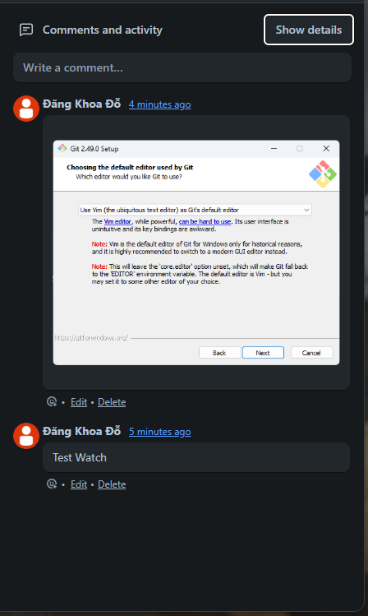
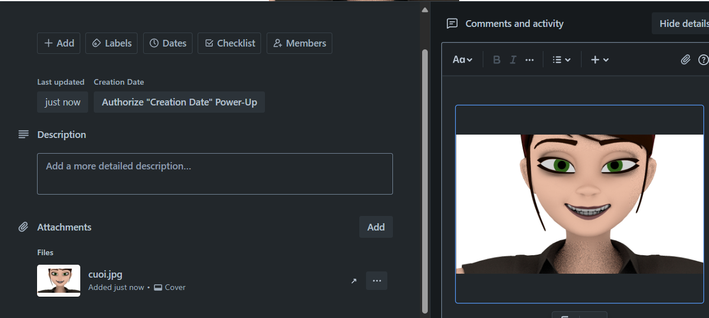
COMMENT IN TRELLO SYSTEM
Atachment
Comment

Slide 44
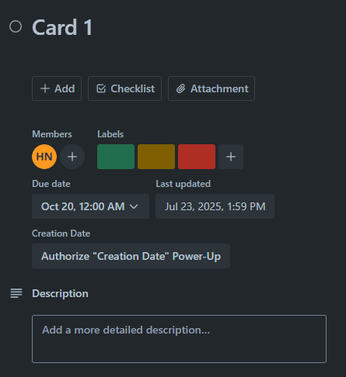

COMMENT IN TRELLO SYSTEM
Label
Label

Slide 45

CARD, ATTACHMENT, COMMENT, REACTION RELATIONSHIP

Slide 46


CARDS IN TRELLO SYSTEM
FieldItem
CustomField
FieldValue
FieldItem

Slide 47

Visily
Card, CustomField, FieldValue, FieldItem(Thông)
,
,

Slide 48



STICKERS IN TRELLO SYSTEM
Click Here
Drag To Here
Sticker

Slide 49

STICKERS IN TRELLO SYSTEM

Slide 50

HOME TAB IN TRELLO SYSTEM
Activity
TemplateCategory
Template

Slide 51

NOTIFICATION IN TRELLO SYSTEM
Notification

Slide 52

ACTIVITY, NOTIFICATION RELATIONSHIP

Slide 53

COLLECTION IN TRELLO SYSTEM
Collection
Board

Slide 54

COLLECTION, BOARD, BOARDCOLLECTION RELATIONSHIP

Slide 55

NOTIFICATION IN TRELLO SYSTEM
Notification
Activity

Slide 56

Q&A
Thank you
Intern | Trello Team

Slide 58
bbv template EN
How-to guides

Slide 59


bbv Master layouts & slide library
Insert new slide
1
Click on «New Slide»
1
2
Select layout
Choose the desired layout from the pre-programmed master layouts.
2
🡪
Or select layout from slide library

Slide 60




Transfer of existing slides into the new Master
1
2
3
4
Insert original slide
Copy slide in original presentation with Ctrl+C.
In the target presentation, select the slide after which the original slide is to be inserted.
Select in the tab «Home / Paste / Use Destination Theme».
Assign slide layout
Select the inserted slide
Select the desired layout in the tab «Home / Layout».
Adjust slide manually
Check all slide contents such as text blocks, images, etc. for position and size and manually adjust them to the new layout grid.
Check design
Independently check:
Font type, sizes and font colours
Colours of graphic elements
Text alignment
Coherence of the overall picture
Important:
When transferring existing slides, always carry out all four steps.

Slide 61


Change icon colour
Approach
Notes
Select icon
In the tab «Graphics Format» under «Graphics Styles», use «Graphics Fill» to change the colour
For some icons, the colour can be changed by using «Graphics Outline» instead of «Graphics Fill».
The colour cannot be changed if an icon is inserted as a picture. In this case, after selecting the icon, the tab «Picture Format» appears instead of «Graphics Format».
Best vector file format for icons: *.svg

Slide 62






Insert image into placeholder
Insert image from external source
Click on the image icon, select image from Sharepoint or other source
The bbv image library is here locally located: C:\Users\Public\bbv_templates\Marketing\PPT-Bibliotheken\Bilder-Bibliothek
Or: copy image from external source with Ctrl+C, select the placeholder, then paste with Ctrl+V
Adjust
Select the image
Click in the tab «Picture Format» on «Crop»
Adjust the image composition by moving the image
Resize the image by clicking and dragging the outer circles.
Click again on «Crop» to finish the adjustments

Slide 63






Insert image into mock-up screen (mobile/laptop)
Mock-up
Paste image
Copy image from external source with Ctrl+C and paste with Ctrl+V
Image mask
Adjust size & determine image area:
Place image behind image mask
Adjust image size and determine image area
Image mask
Crop image to image mask
Select image
Select image mask
Click in the tab «Shape Format / Merge Shapes» on «Intersect»
Combine image with mock-up
Place image behind mock-up
Activate image and mock-up and align both horizontally (Align Center) and vertically (Align Middle)
Group image and mock-up with Ctrl+G

Slide 64
bbv template EN
Style guide

Slide 65



Working area, guides & ruler
Working area
Depending on the slide, a single-column layout, a 2-column or 3-column layout is used.
Display the ruler and guides in the «View» tab.

Slide 66


bbv colour theme
Always OK!
Never, please!
Default text colours
Main accent
Colours for diagrams, charts, graphs etc.
Use selectively and sparingly
Never, please!
Colours for diagrams, charts, graphs etc.
Colours for diagrams, charts, graphs etc.

